Slide 1


Leveraging EF Core in OC Context
Paul Bull
Orchard Harvest
Conference 2026

Slide 2
About Me
Paul Bull
Founder CleverGraft
Website: http://www.clevergraft.com
GitHub: https://github.com/pbull001/orchardefcore.git
Linkedin: https://www.linkedin.com/in/paulbull/
Orchard Harvest
Conference 2026

Slide 3
Agenda
The Case
The Journey
The Solution
Orchard Harvest
Conference 2026

Slide 4
The Case
Orchard Harvest
Conference 2026

Slide 5
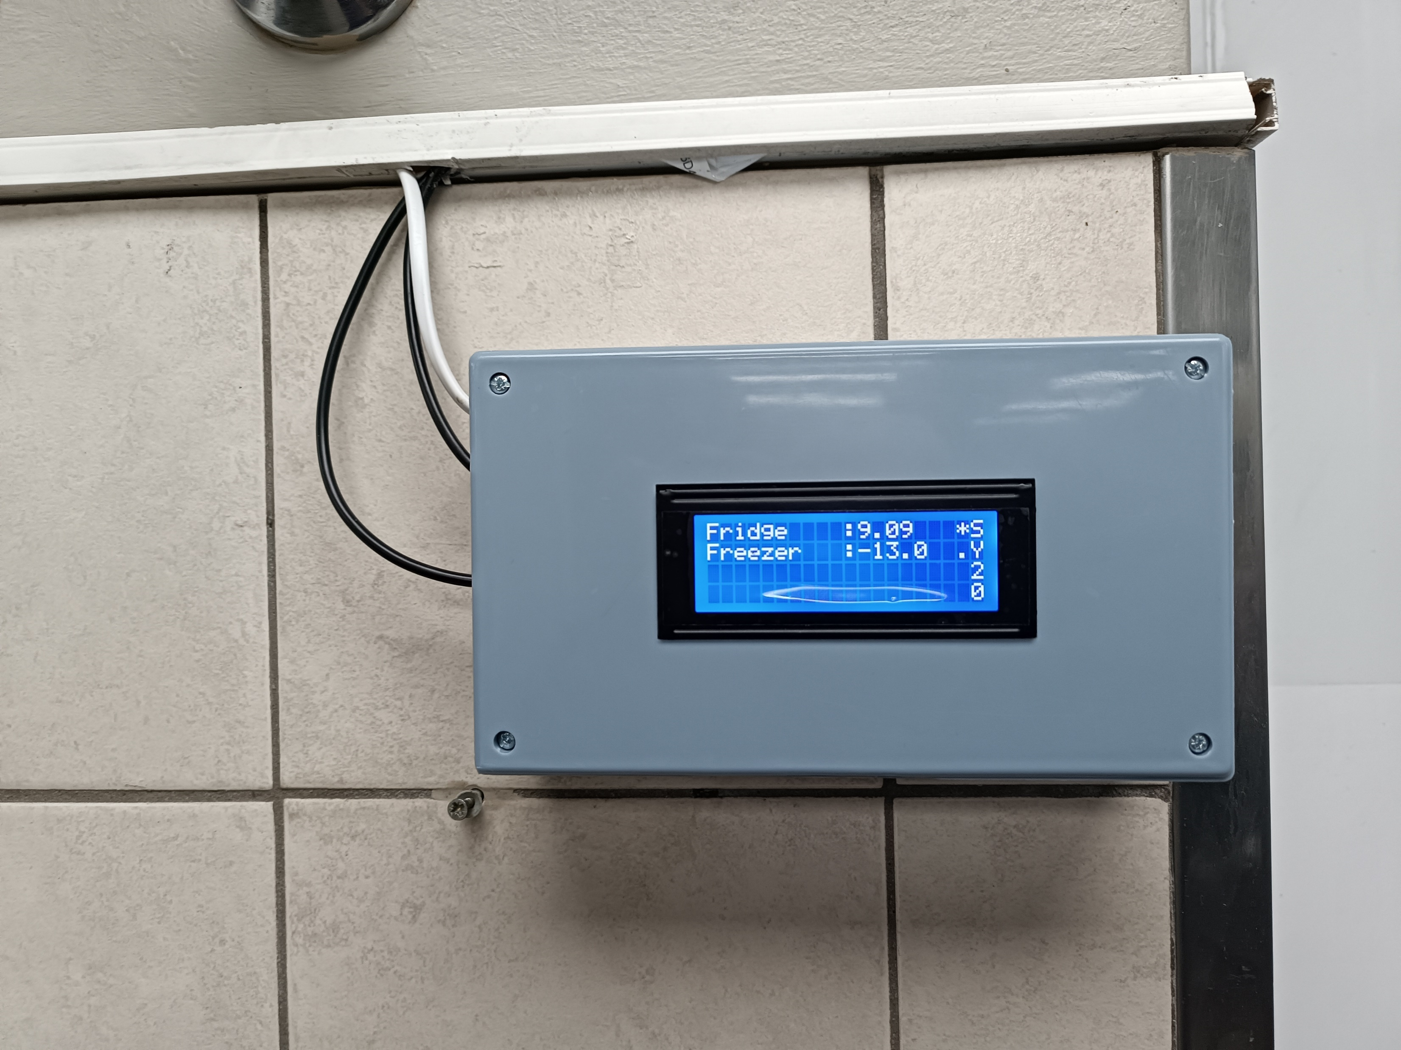
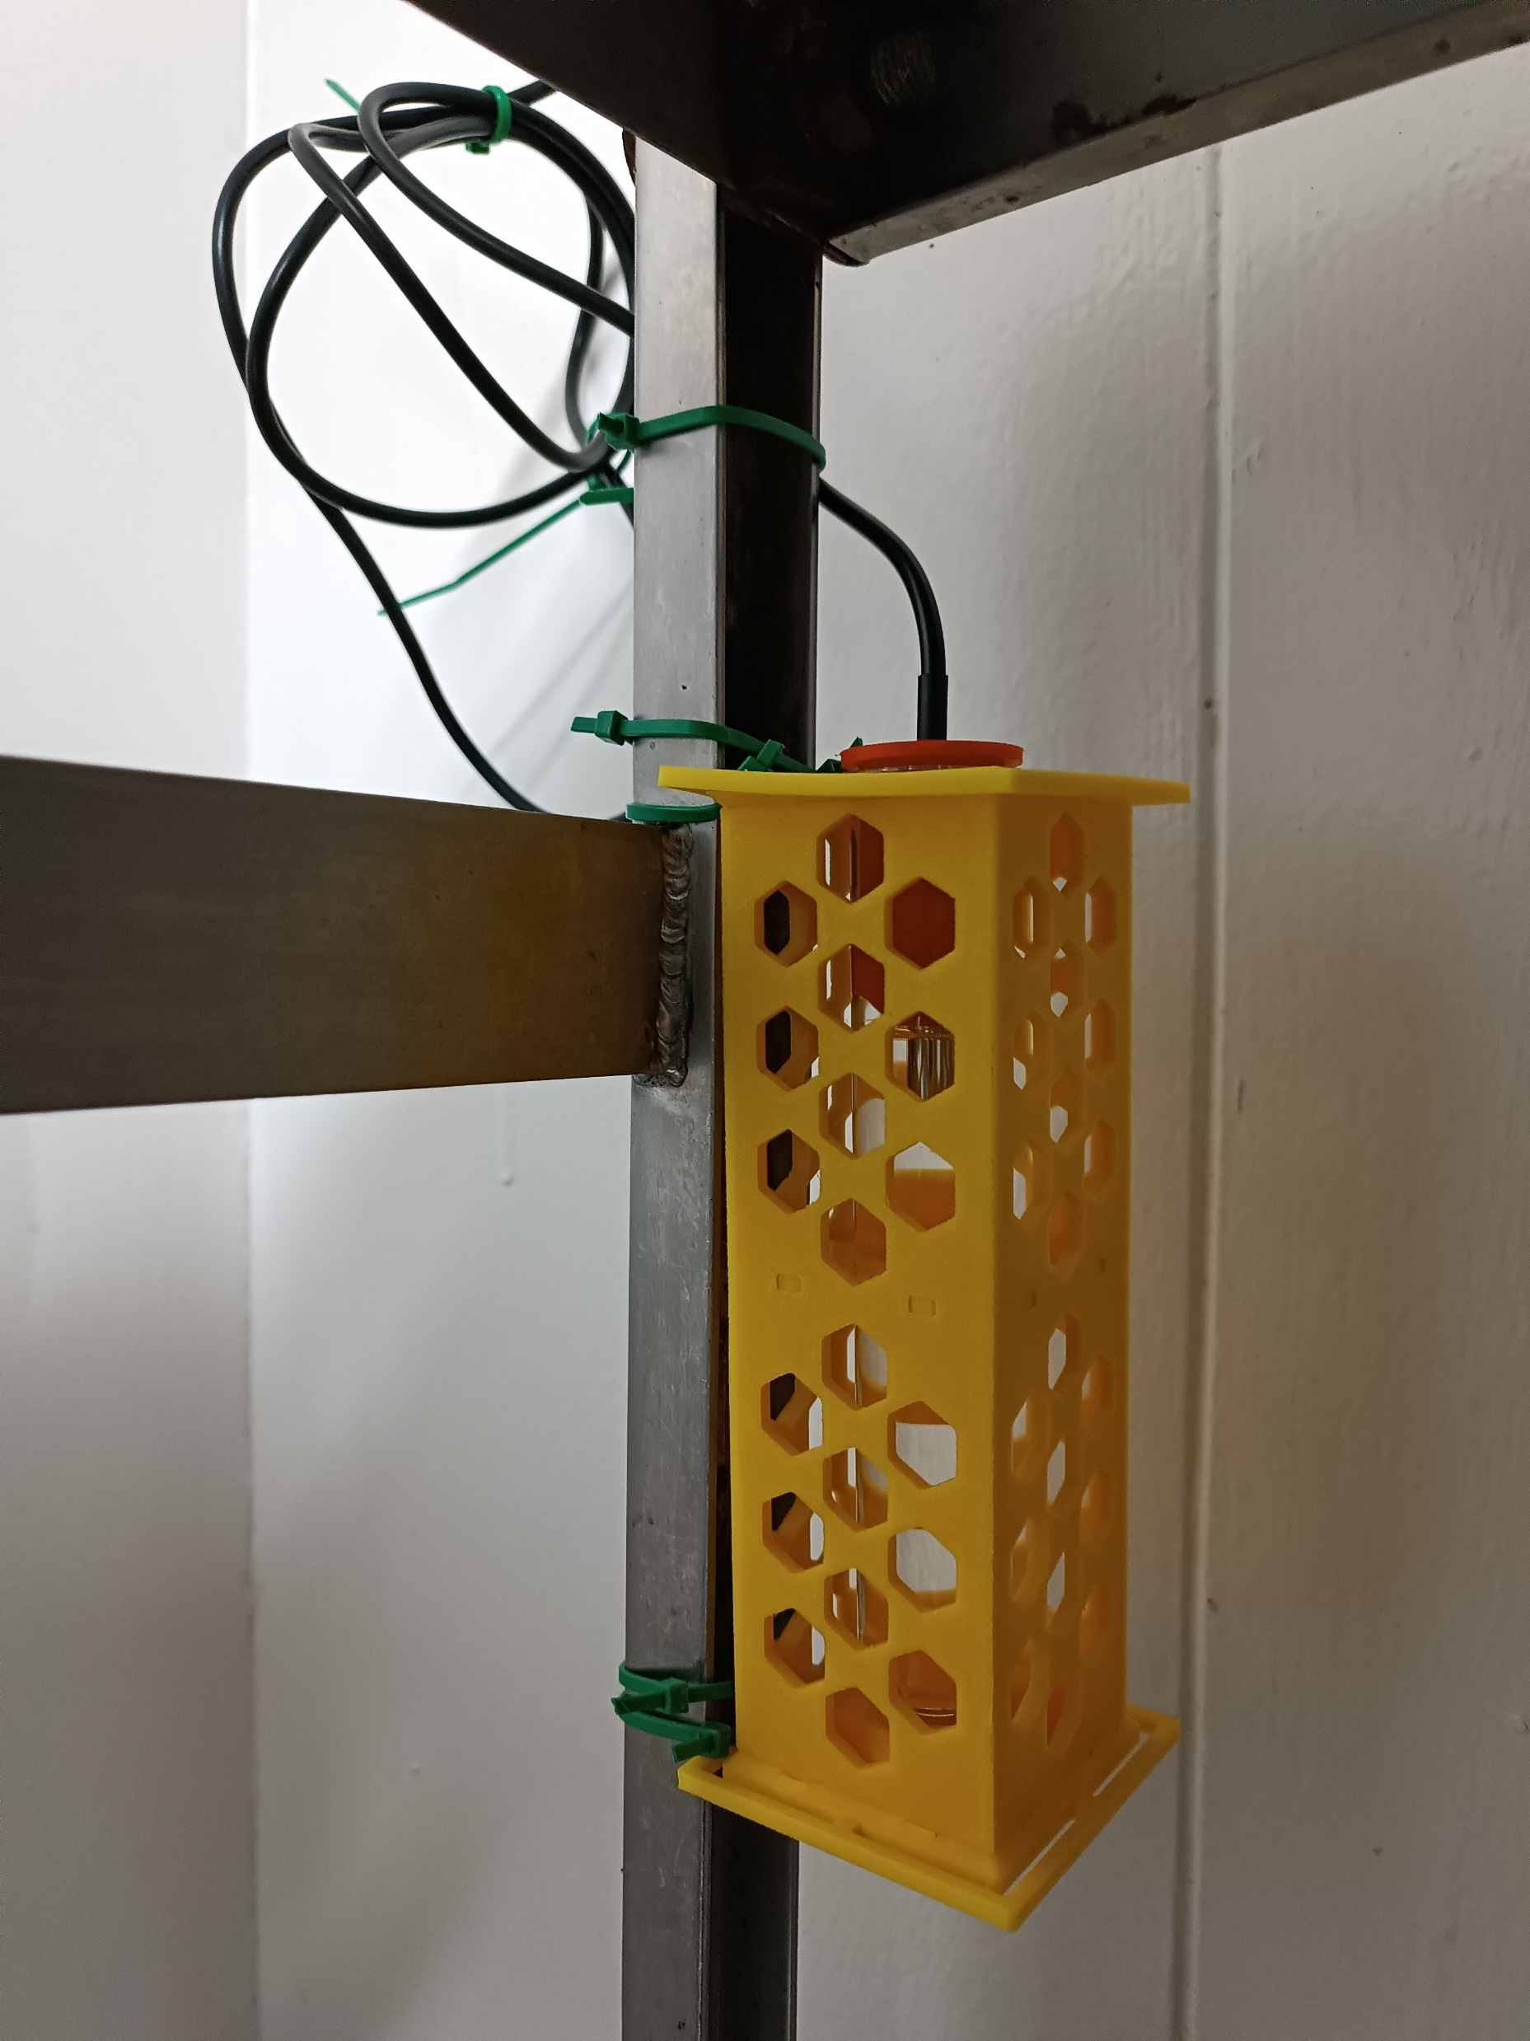
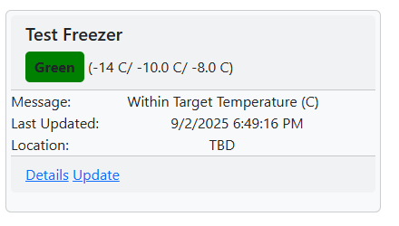
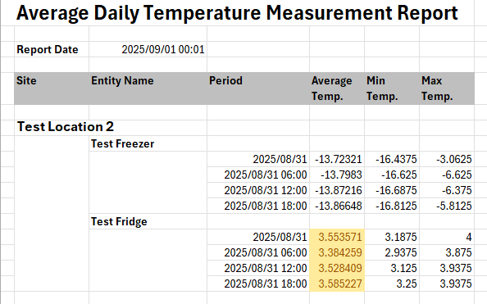
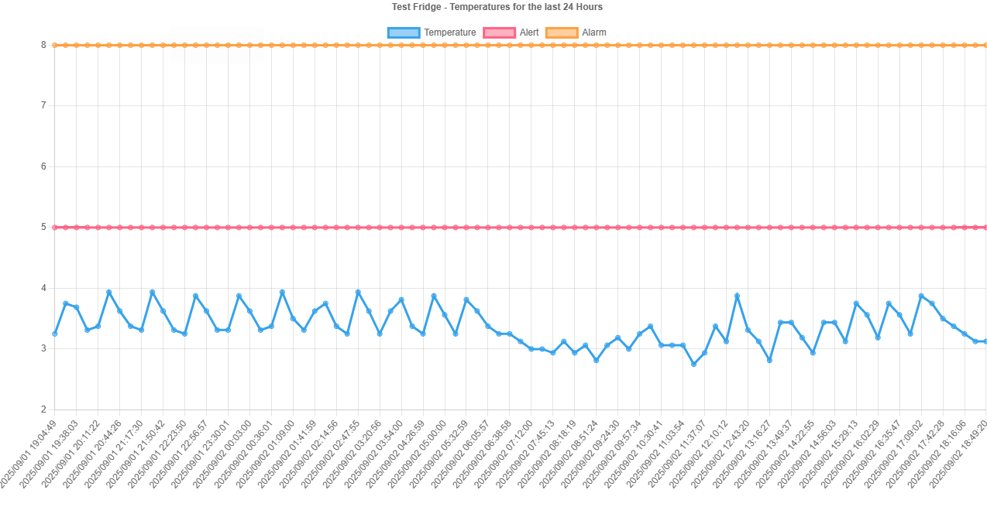
The Case – IOT device and State management in a multi-tenanted context
Cell Phone
SMS
Monitored Equipment
(sensor/s attached)
Dashboards
Platform
Internet Connection (WiFi/GSM)
Sensor Controller
Sensors
Sensor Info
Browser
Reports
Platform Updates
Events (Sensor Info)
Issue Identification Rules
Notification Rules
Device and Event Definitions
Sensor controller is multi-protocol enabled
( sensors from large selection can be attached)
Messages, Dashboards, Reports, Updates all configurable.
Platform hosting is configurable:
In-cloud (Azure)
On-prem (Container)
Workflows
Reports
Analytics
Database
Users
Each client has their “own” database
Platform Capabilities
Orchard Harvest
Conference 2026

Slide 6
Event Related Entities
Requirements
Solution to be integrated via DI into app
Setup experience to create relevant tables, indexes and constraints in the tenant’s db using schema name from tenant setup.
CRUD capabilities across all entities
Ability to retrieve Entities with directly related entities as POCOs
Bulk “copy” capability – copy data from “template” db when a new tenant created
Filter Events using EventQueryOption params
Query PlatformEvents
Create PlatformEvents
Query Recepients in a Group
Query EventTypes
Query Devices
Query DeviceTypes
Query Devices in a Group
DeviceGroup
1:m
1:m
m:1
m:1
EventType
Event
Device
DeviceType
1:m
PlatformEventType
PlatformEvent
1:m
m:1
Recipient
Recipient_Group
RecipientGroup

Slide 7
The Journey
Orchard Harvest
Conference 2026

Slide 8



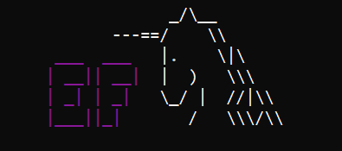
The Journey to sadness
The Beginning
The edge of the swamp
Into the swamp
DbContext
ef migrations add …
ef database update
single database
Development progresses ..
connection strings
schema
DbContext
ef migrations add …
ef database update
multiple databases
Development slows ..
multiple snap shots
dev, test, uat
DbContext
ef migrations add …
ef database update
multiple databases
Miserable future becomes apparent!
multiple snaps shots
dev, test, uat
multiple client databases
schema segmentation

Slide 9
The Solution
Orchard Harvest
Conference 2026

Slide 10
Into the light – maker style
Things we like and want to leverage in a better future …
EF Core dbcontext and associated joy
Orchardcore.net multi-tenant solution
Orchardcore.net schema management
Things we want to make go away
EF core database management process
Need to solve for
DbContext usage in Orcharcore.net module using connection string and schema client segmentation
Database management within the Orchardcore.net multi-tenant context

Slide 11
The solution
Access Data using EFCore
DBContext
Schema
Registration
Manage DB using Orchardcore.net
Migrations.cs

Slide 12
Accessing data using EFCore
DbContext Constructors
Service Collection Extension
public OverwatchDbContext(
ILogger<OverwatchDbContext> logger,
DbContextOptions<OverwatchDbContext> options) : base(options)
{
_logger = logger;
_schema = null;
Console.WriteLine("OverwatchDbContext created without schema");
}
public OverwatchDbContext(
ILogger<OverwatchDbContext> logger,
DbContextOptions<OverwatchDbContext> options,
string schema) : base(options)
{
_logger = logger;
_schema = schema;
_logger.LogInformation($"OverwatchDbContext created with schema: {_schema}");
}
public static class OverwatchServiceCollectionExtensions
{
public static IServiceCollection AddOverwatchDatabase(this IServiceCollection services)
Module Startup
services.AddOverwatchDatabase();

Slide 13
How & Who
AddOverwatchDatabase
// 2. Register the "Who" (Instance Factory)
services.AddScoped<OverwatchDbContext>(sp =>
{
var options = sp.GetRequiredService<DbContextOptions<OverwatchDbContext>>();
var logger = sp.GetRequiredService<ILogger<OverwatchDbContext>>();
var shellConfig = sp.GetRequiredService<IShellConfiguration>();
var dbProvider = (string)shellConfig["DatabaseProvider"] ?? "none";
string? schema;
switch (dbProvider.ToLower())
{
case "sqlconnection":
schema = shellConfig["Schema"] ?? "dbo";
break;
case "sqlite":
schema = null;
break;
default:
schema = "dbo";
break;
}
//var schema = shellConfig["TablePrefix"] ?? shellConfig["Schema"] ?? "dbo";
if (schema is null)
{
return new OverwatchDbContext(logger, options);
}
else
{
return new OverwatchDbContext(logger, options, schema);
}
});
return services;
// 1. Register the "How" (Options)
services.AddDbContext<OverwatchDbContext>((sp, options) =>
{
var shellConfig = sp.GetRequiredService<IShellConfiguration>();
var conn = shellConfig["ConnectionString"];
var provider = shellConfig["DatabaseProvider"];
if (provider == "SqlConnection")
{
options.UseSqlServer($"{conn};MultipleActiveResultSets=True;");
}
else if (provider == "Sqlite")
{
var accessor = sp.GetRequiredService<IDbConnectionAccessor>();
options.UseSqlite(accessor.CreateConnection());
//options.UseSqlite(conn);
}
else
{
throw new NotSupportedException($"Unsupported provider '{provider}'.");
}
});

Slide 14
Other DBContext things
Properties
Relationship
modelBuilder.Entity<Event>(events =>
{
// Chain these methods with a dot (.)
events.ToTable("Event");
events.HasKey(e => e.EventId);
events.Property(e => e.EventDateTime)
…..
events.Property(o => o.Data)
.HasColumnName("Data")
.HasColumnType("nvarchar(max)")
.HasConversion(jsonConverter)
.Metadata.SetValueComparer(jsonNodeComparer);
events.HasIndex(o => o.EventId);
});
modelBuilder.Entity<GroupRecipient>(gr =>
{
gr.ToTable("GroupRecipient");
gr.HasKey(g => new { g.GroupId, g.RecipientId });
gr.HasOne(g => g.Group)
.WithMany(rs => rs.GroupRecipients)
.HasForeignKey(g => g.GroupId)
.OnDelete(DeleteBehavior.Cascade);
gr.HasOne(r => r.Recipient)
.WithMany(gs => gs.GroupRecipients)
.HasForeignKey(gr => gr.RecipientId)
.OnDelete(DeleteBehavior.Cascade);
});

Slide 15
Managing the EFCore Tables
public async Task<int> Create()
{
// Get the table prefix from the configuration
var prefix = _shellConfiguration["TablePrefix"] ?? string.Empty;
var schema = _shellConfiguration["Schema"] ?? string.Empty;
// EventType table - lookup by code
await SchemaBuilder.AlterTableAsync(nameof(EventType), table => table
.CreateIndex("IX_EventType_Code", nameof(EventType.Code))
);
await SchemaBuilder.CreateTableAsync(nameof(EventType), table => table
.Column<long>(nameof(EventType.EventTypeId), column => column.PrimaryKey().Identity())
.Column<string>(nameof(EventType.Code), column => column.NotNull())
.Column<string>(nameof(EventType.Name), column => column.NotNull())
…..
.Column<bool>(nameof(EventType.HasOnReceiptConditions), column => column.NotNull().WithDefault(false))
);
// Add composite primary key
await SchemaBuilder.AlterTableAsync(nameof(GroupRecipient), table => table
.CreateIndex("PK_GroupRecipient", nameof(GroupRecipient.GroupId), nameof(GroupRecipient.RecipientId))
);

Slide 16
Caveats in Migrations.cs – The Price
3.1 SchemaBuilder defines and evolves the table
All DDL for the shared table is issued from IDataMigration methods (CreateAsync, and successive UpdateFromNAsync methods) using SchemaBuilder.
3.3 Manual synchronization discipline
Because EF Core is given no migration history to check its model against, there is no compiler- or tooling-level guarantee that the DbContext's Fluent API configuration matches the table SchemaBuilder actually produced. Every UpdateFromNAsync that changes the table's structure must be accompanied, in the same change set, by a corresponding update to OnModelCreating.
3.2 The DbContext is configured without migration capability
The DbContext's OnModelCreating configures entity-to-table and property-to-column mappings using Fluent API calls (ToTable, HasColumnName, HasMaxLength, HasConversion, and similar), but the module never calls dotnet ef migrations add. The DbContext's model exists solely to describe, for EF Core's own query translator and change tracker, the shape of a table it does not create or alter.

Slide 17
Questions/ Comments/ Advice
No tomatoes or eggs please ….

